Slide 1


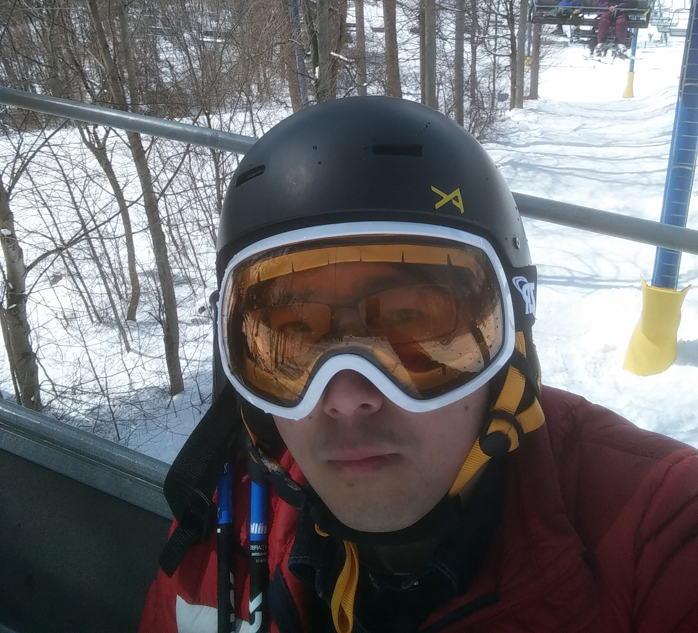



Roy Jiaheng Wang
Undergrad: SCU_ Applied Math
Hometown: Sichuan “Szechuan” _ Hometown of Panda
Previous Experience: Client Manager Intern _ CDRCB
Interests: Sports, Movies, Traveling, Concerts, Petrol Head
Hobbies: Road Trip, Food, Skiing, Hiking, Reading, Singing
Notes:
Just talk the slides.
One key turn point: the Client Manager Intern makes me lose interest in traditional finance service, and helped determine my interest of marketing analytics.

Slide 2



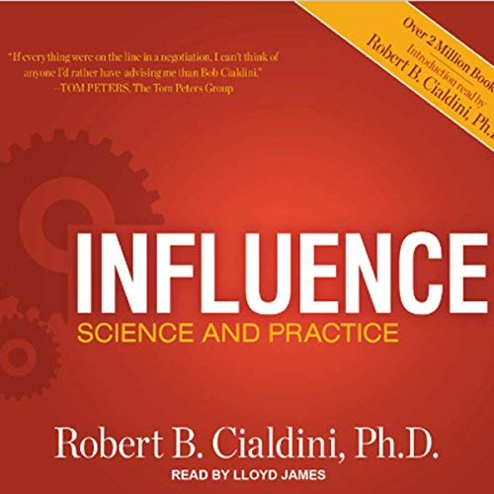
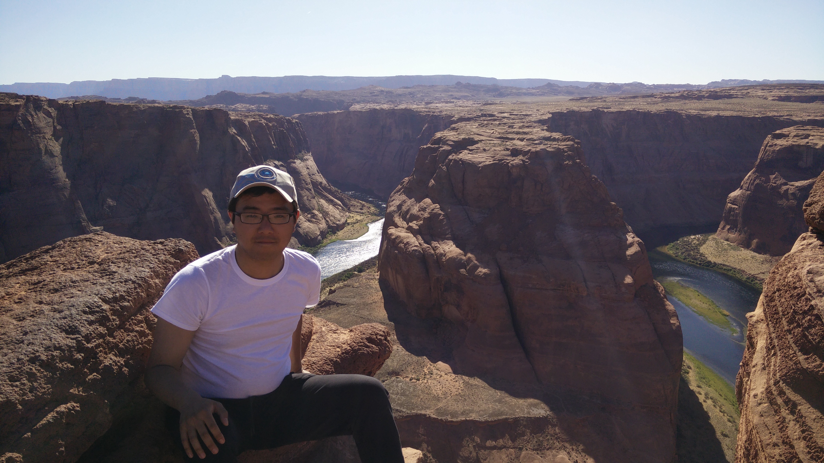
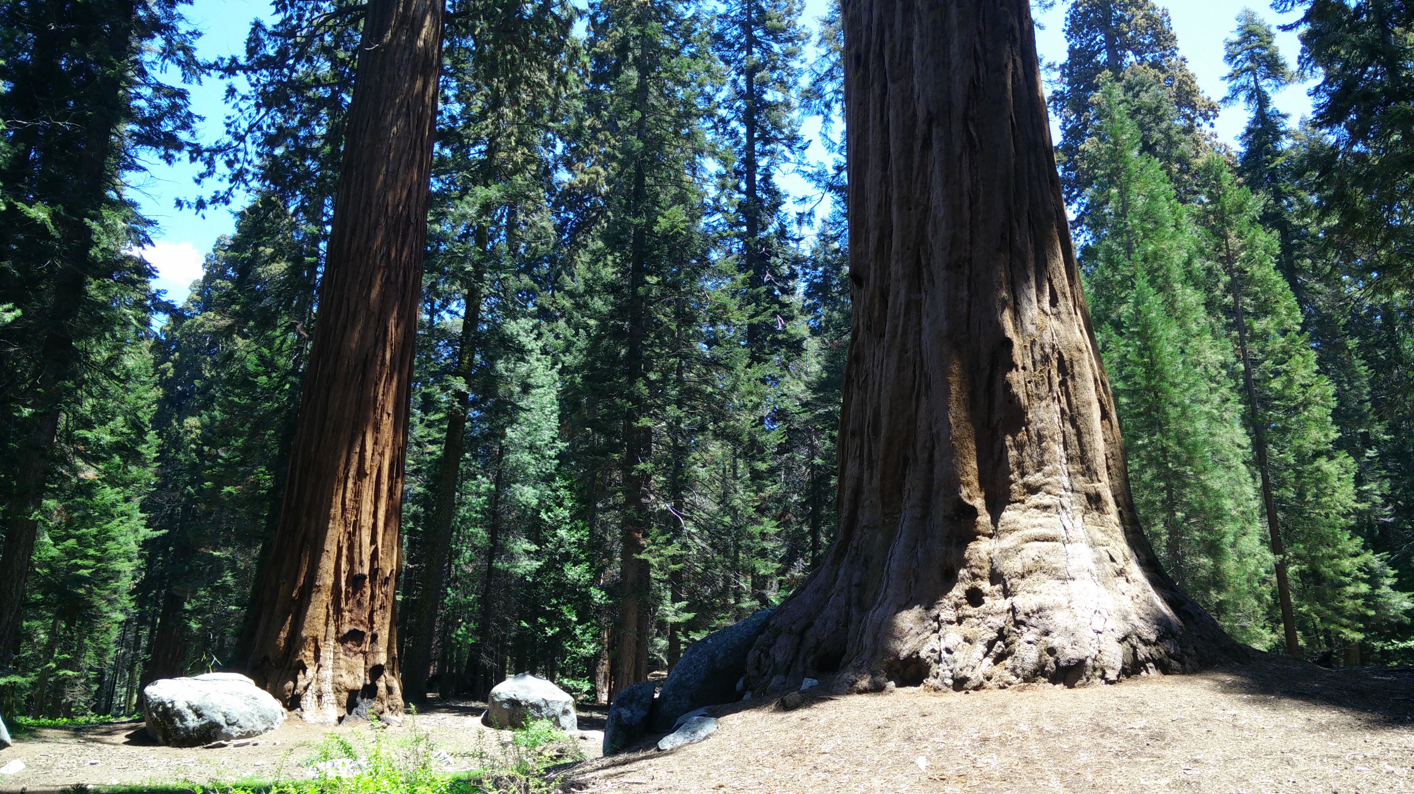
Notes:
Just talk the slides.

Slide 3
Passion-Driven Tenacious Simplify vs. Expand
Notes:
Passion is the best strength which can overcome all trouble.
Of course it is impossible to always do easy things, thus tenacious is crucial. In real-life, it can also be interpret as patience. The reward in life may not come so soon. Stay calm.
One mechanism I find useful is S & E. The part of your life that is not productive or interesting, simplify it as much as possible. Then I’ll have enough time and energy to expand the rest.
Simplify--Subway example, quick, healthy, functional, cheap.
Expand—Studying, Skiing & Sightseeing example, invest hugely in time and money.

